Slide 1
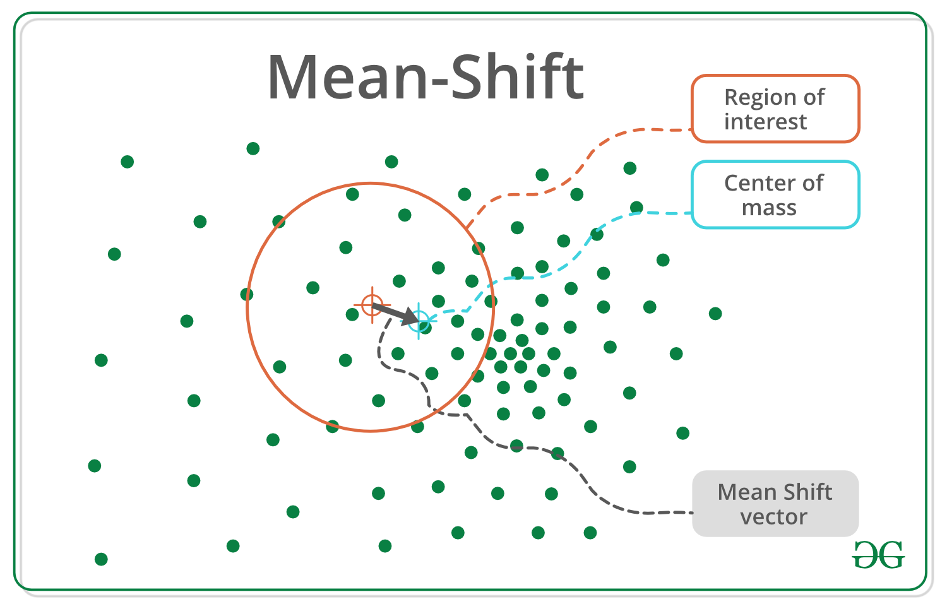
Meanshift is falling under the category of a clustering algorithm in contrast of Unsupervised learning that assigns the data points to the clusters iteratively by shifting points towards the mode (mode is the highest density of data points in the region, in the context of the Meanshift). As such, it is also known as the Mode-seeking algorithm

Slide 2
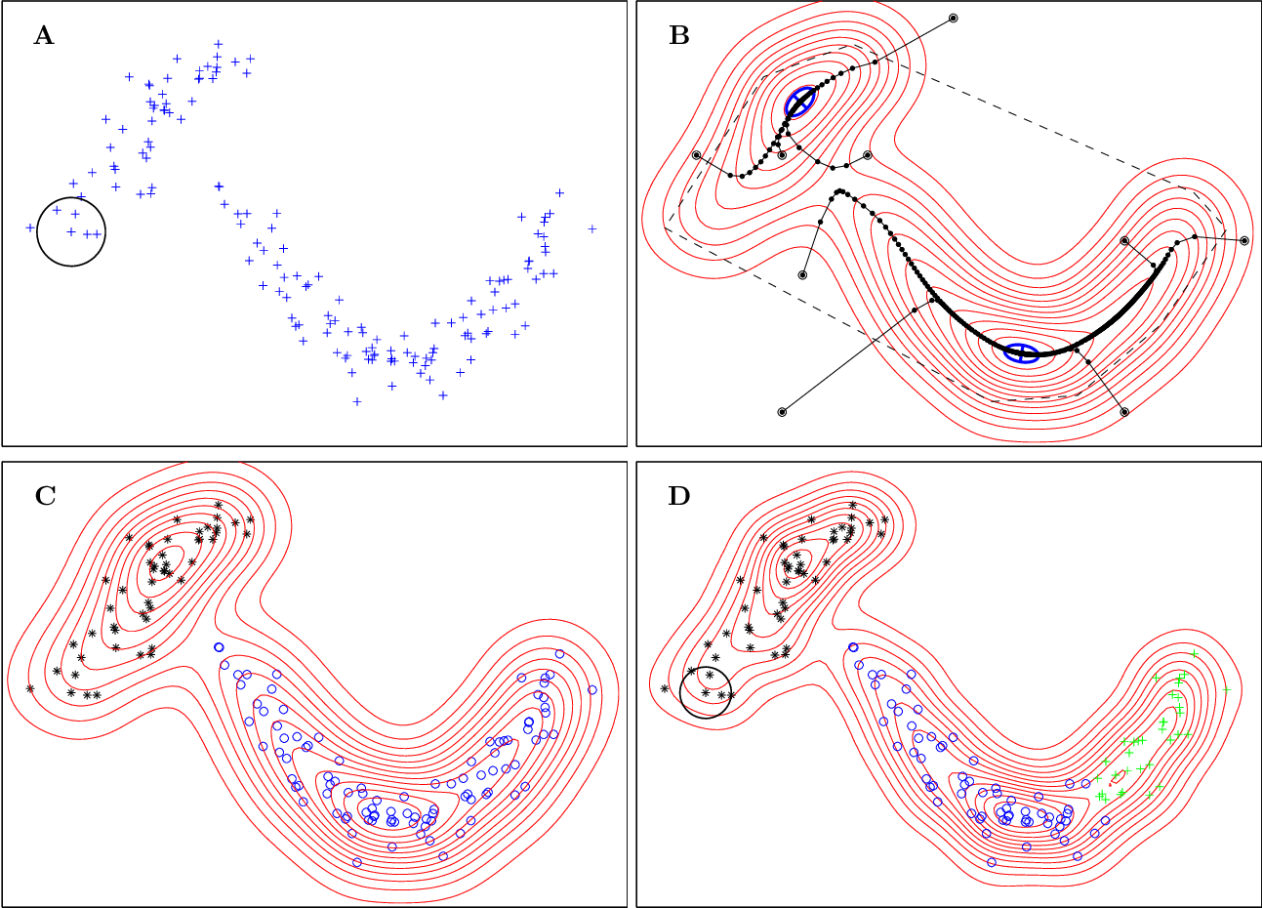
Illustration of how mean shift works

Slide 3
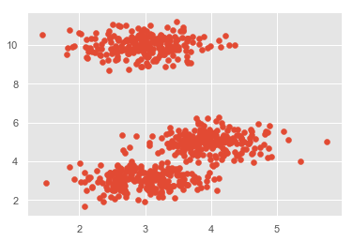
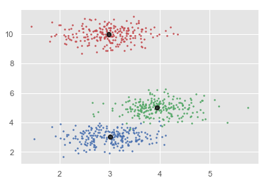
Step 1 − First, start with the data points assigned to a cluster of their own.
Step 2 − Next, this algorithm will compute the centroids.
Step 3 − In this step, location of new centroids will be updated.
Step 4 − Now, the process will be iterated and moved to the higher density region.
Step 5 − At last, it will be stopped once the centroids reach at position from where it cannot move further.

